Slide 1


An app designed to educate and engage children about climate change

Slide 2

Notes:
CESCA:
Welcome to our climate app, Earth Hero
We firstly have a promotional video explaining our app

Slide 3
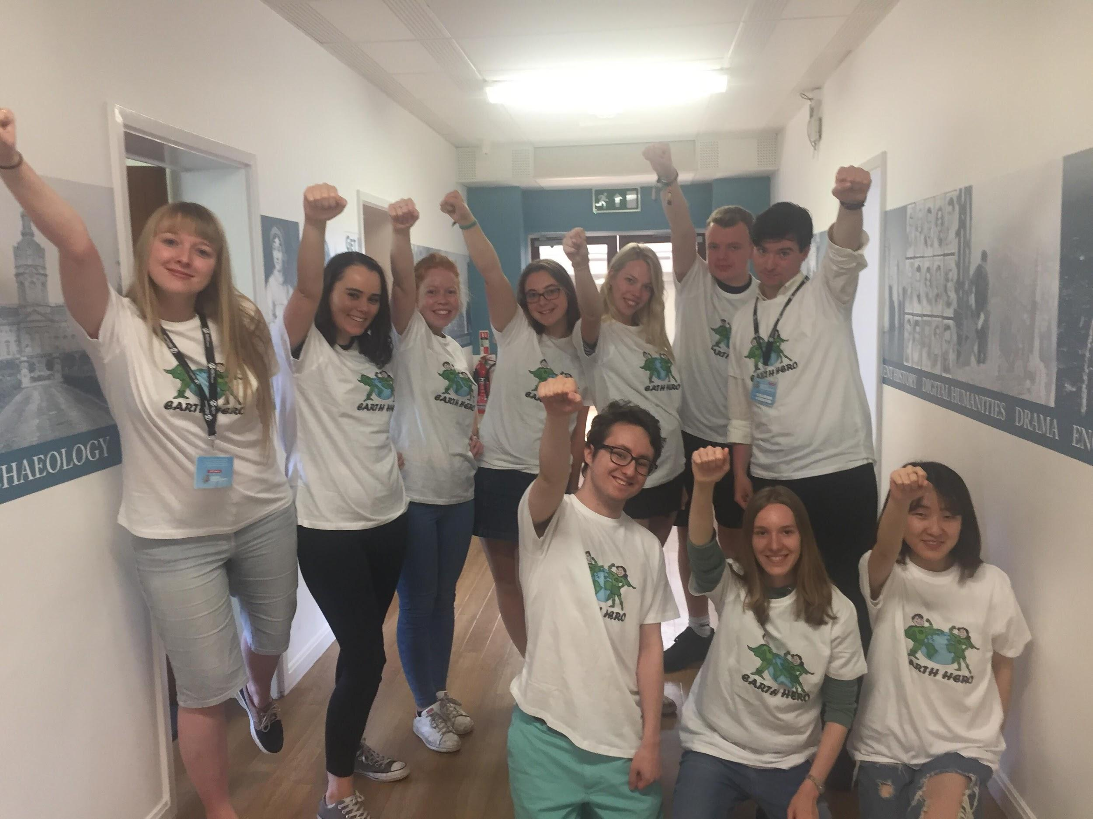

Slide 4
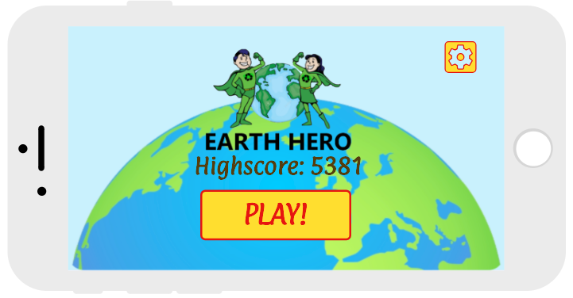

Slide 5
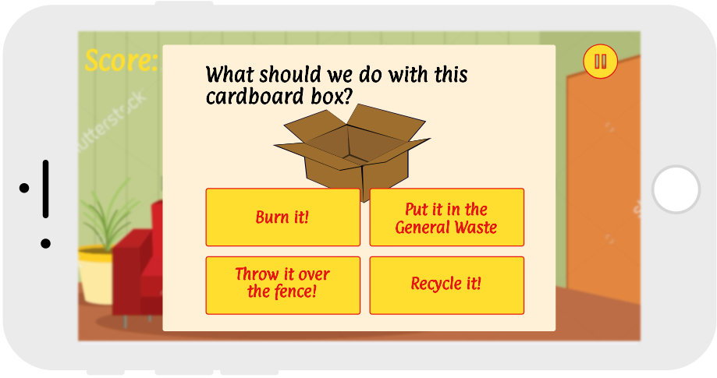
Our App

Slide 6
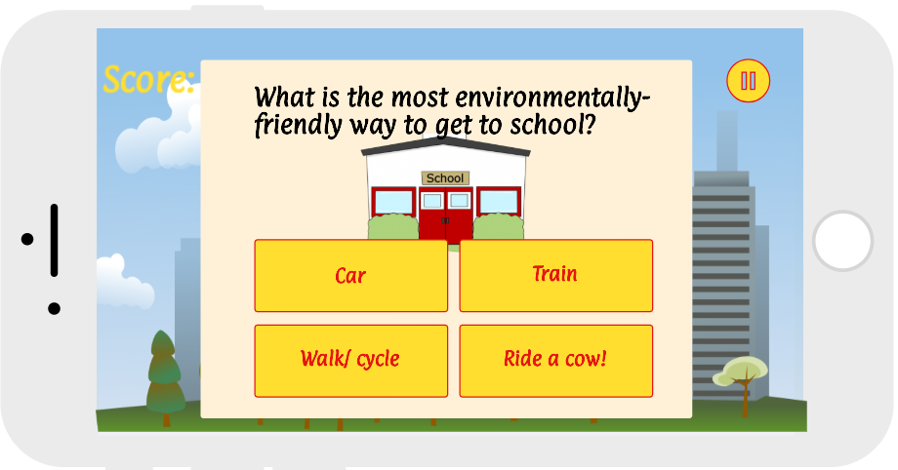

Slide 7
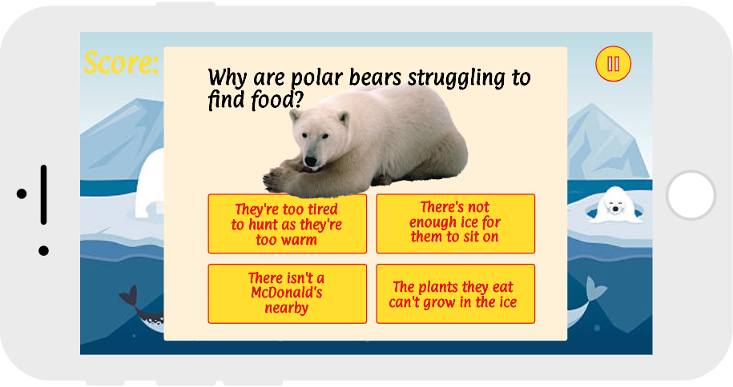

Slide 8
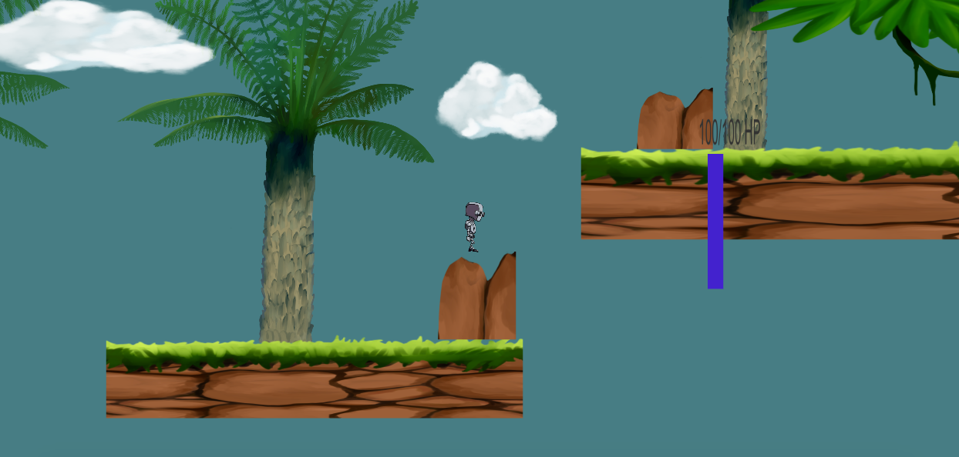
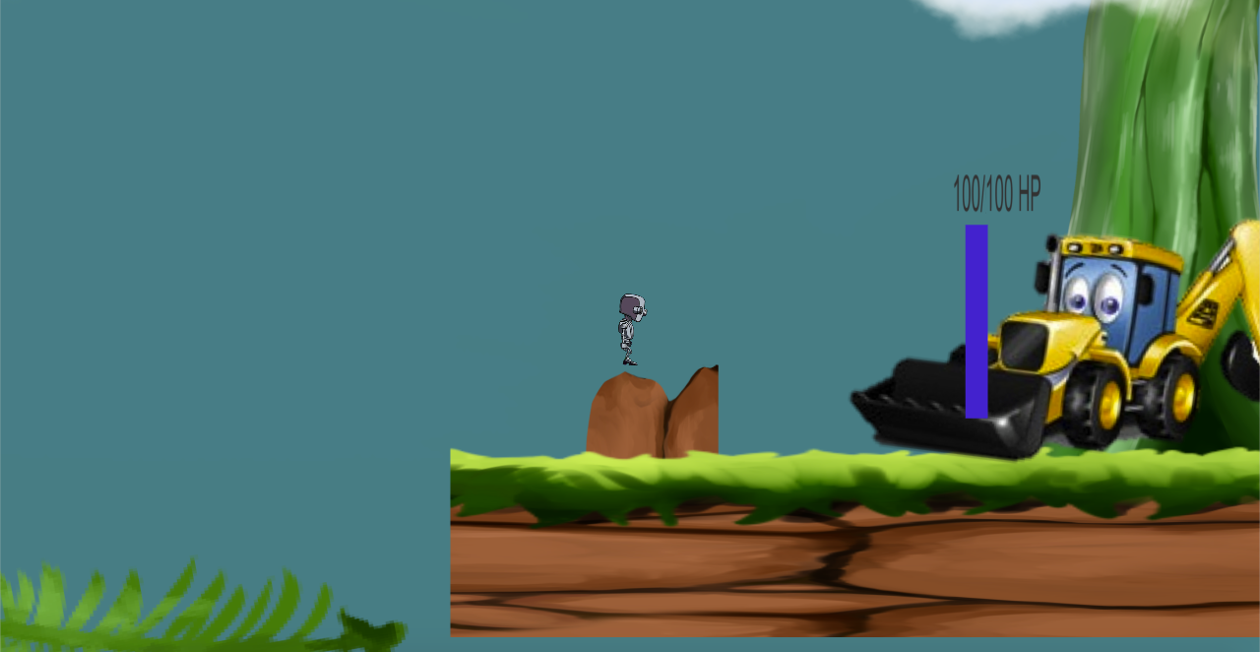
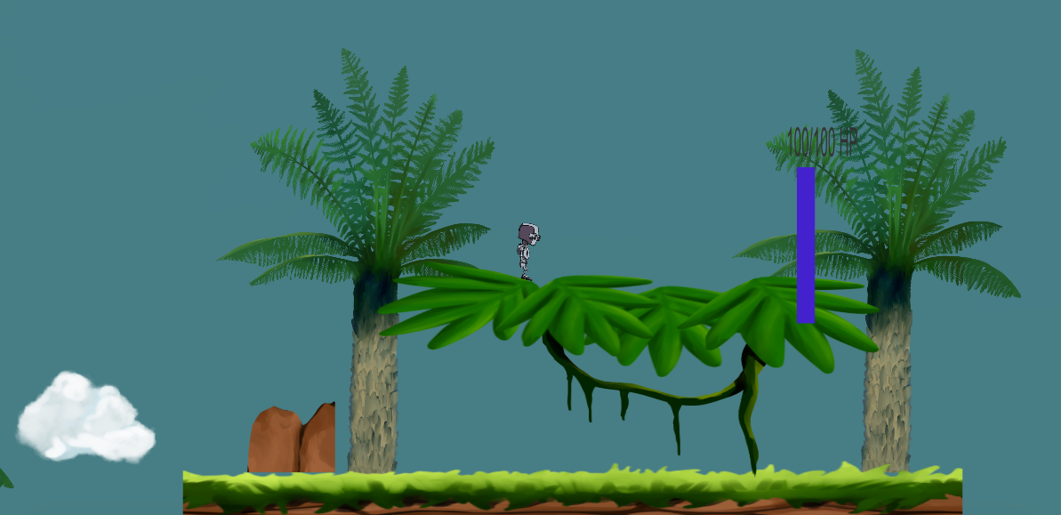

Slide 9



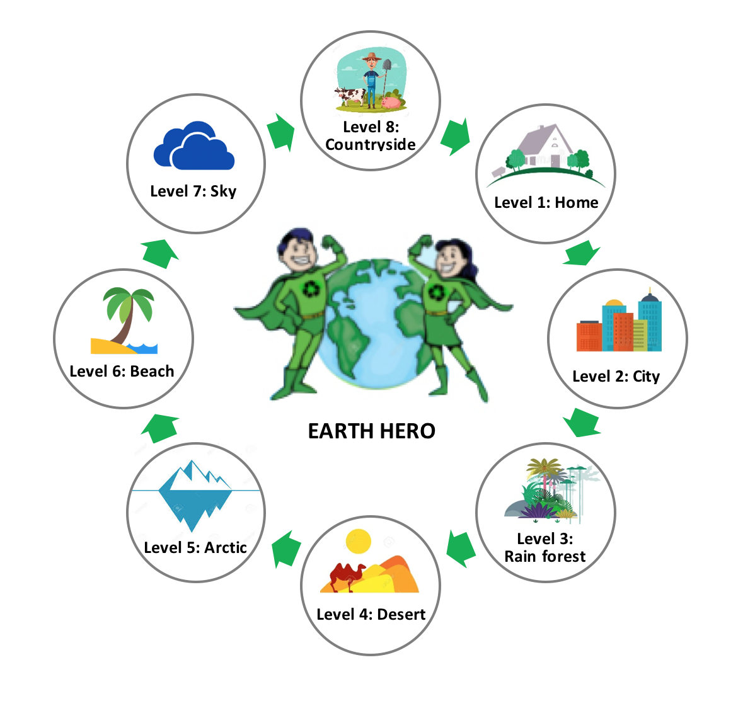



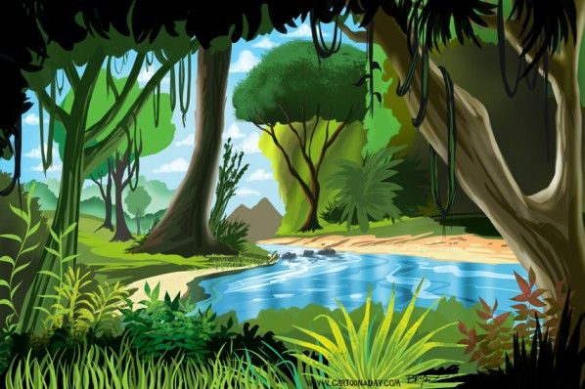

Game Levels

Slide 10
Timeline of Progress
Monday
Research
Brainstorm app ideas
Wednesday
Attended debate
Presentation to the children
Finalising poster
Social media
Tuesday
App development
Target market engagement
Logo development
Market research
Thursday
Preparation for business pitch
Submission of output
Friday
Business pitch
App showcase
Notes:
WINNIE: This is a flowchart showing our progression over the week

Slide 11
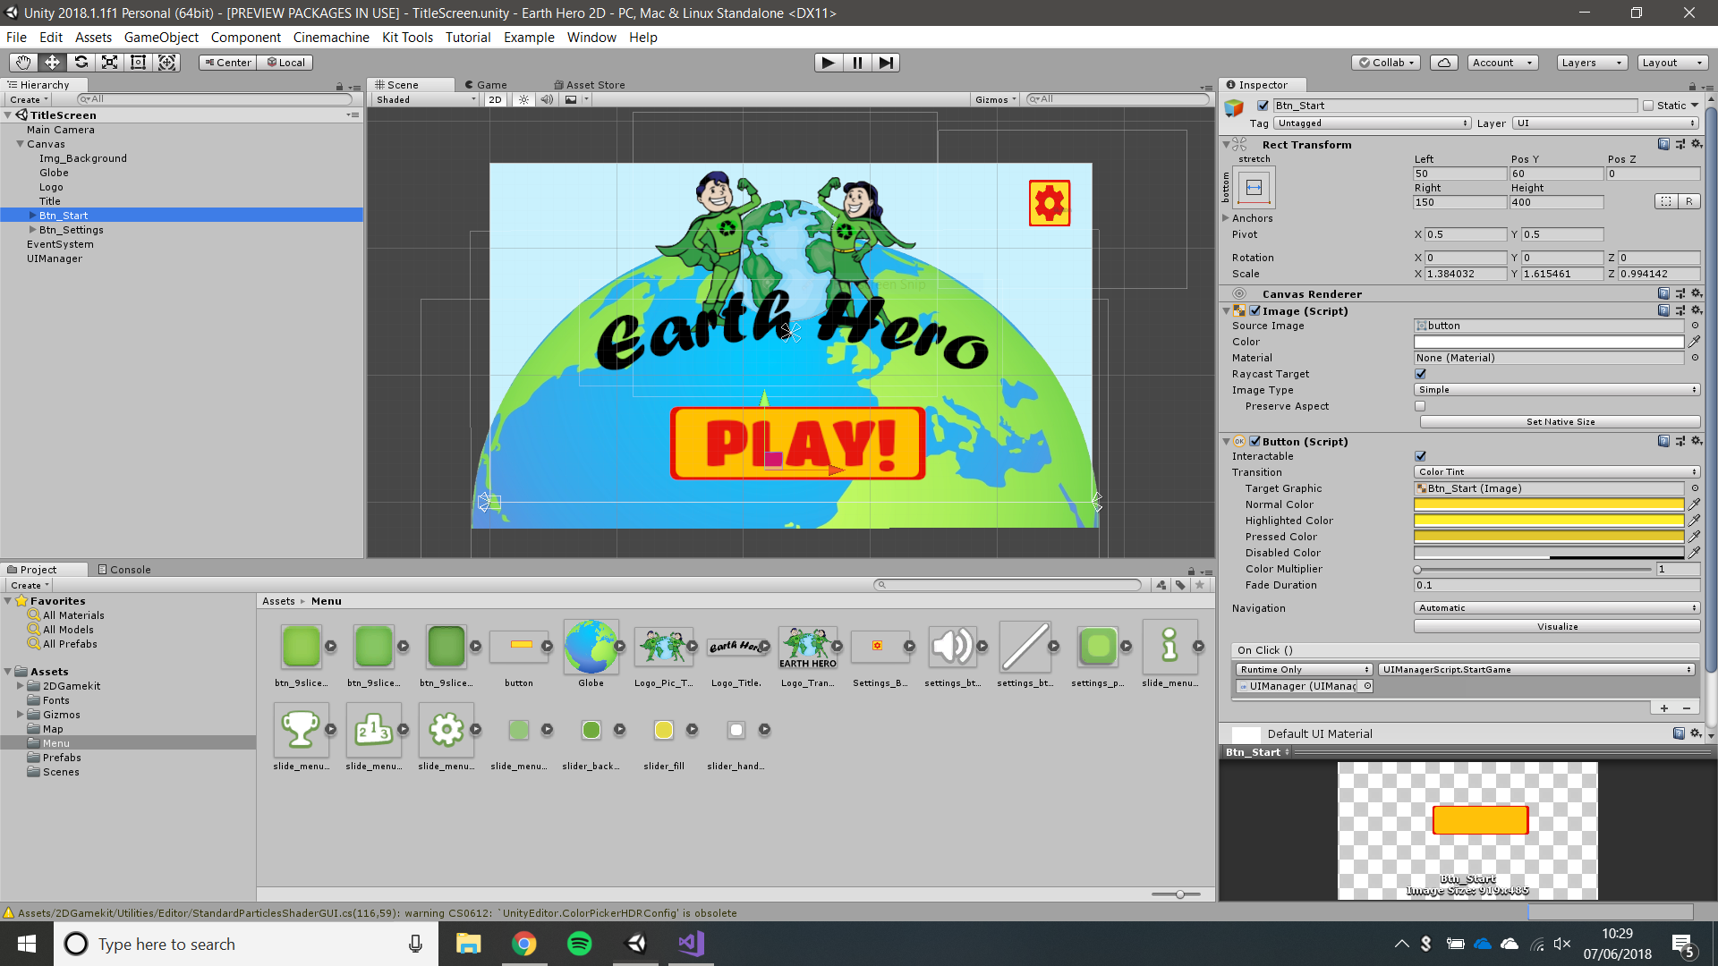
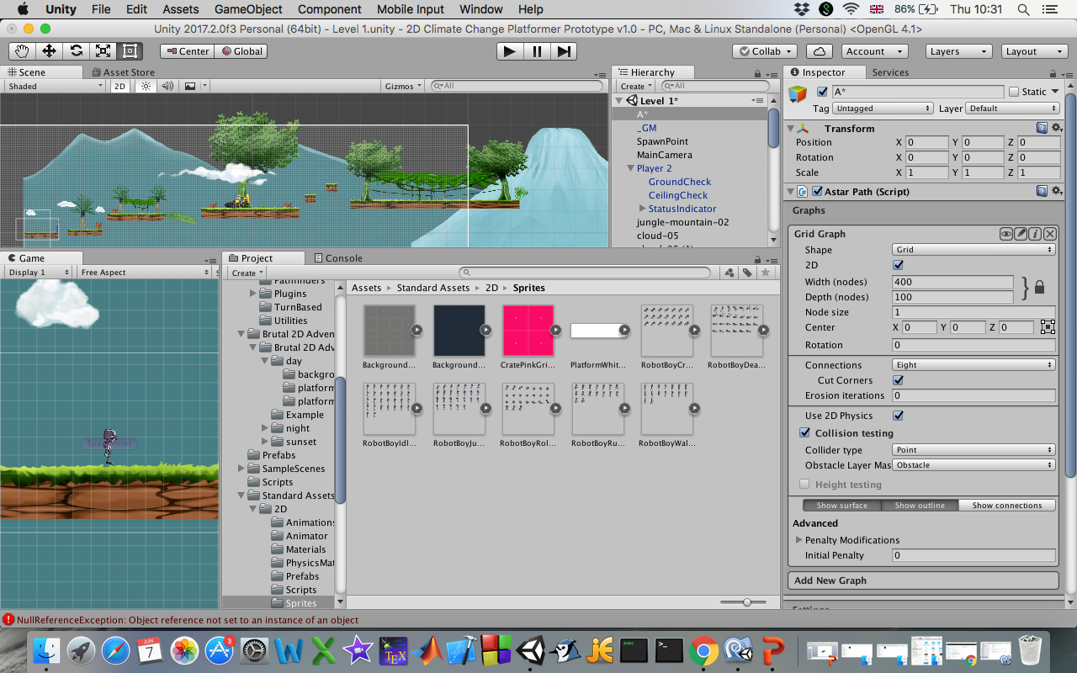
App Programming

Slide 12




Market Research - School Visit

Slide 13
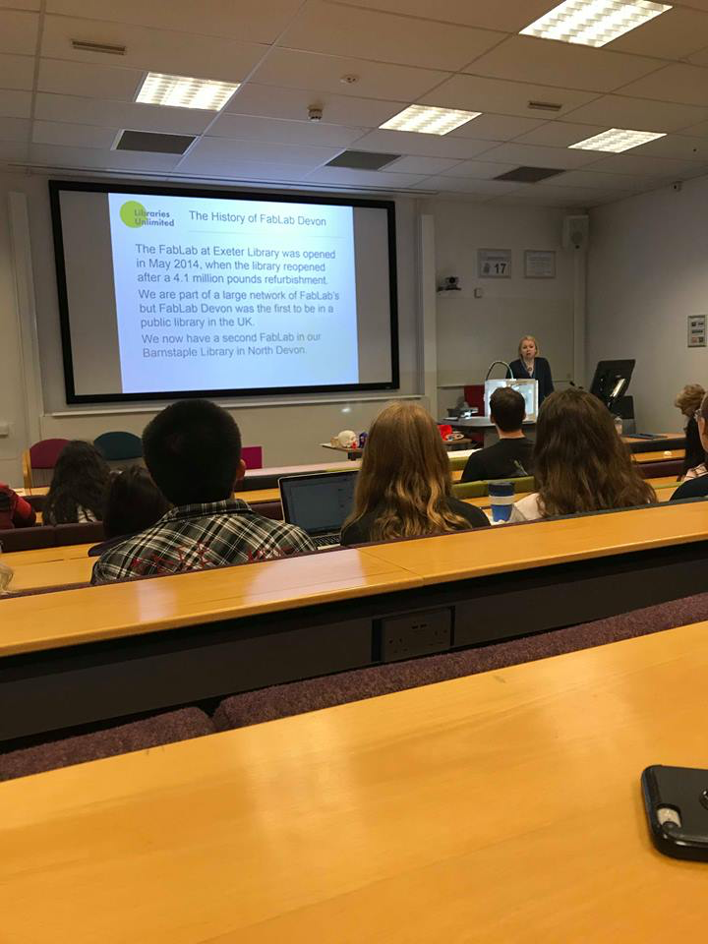
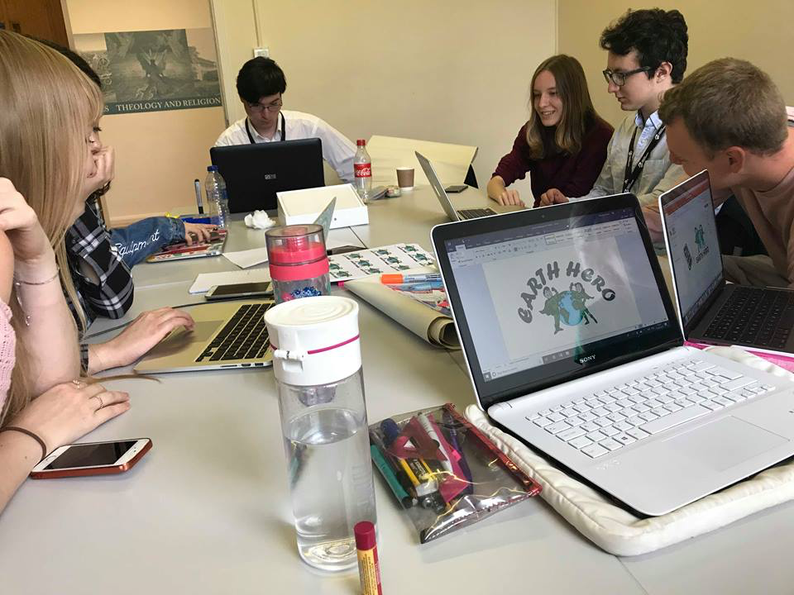
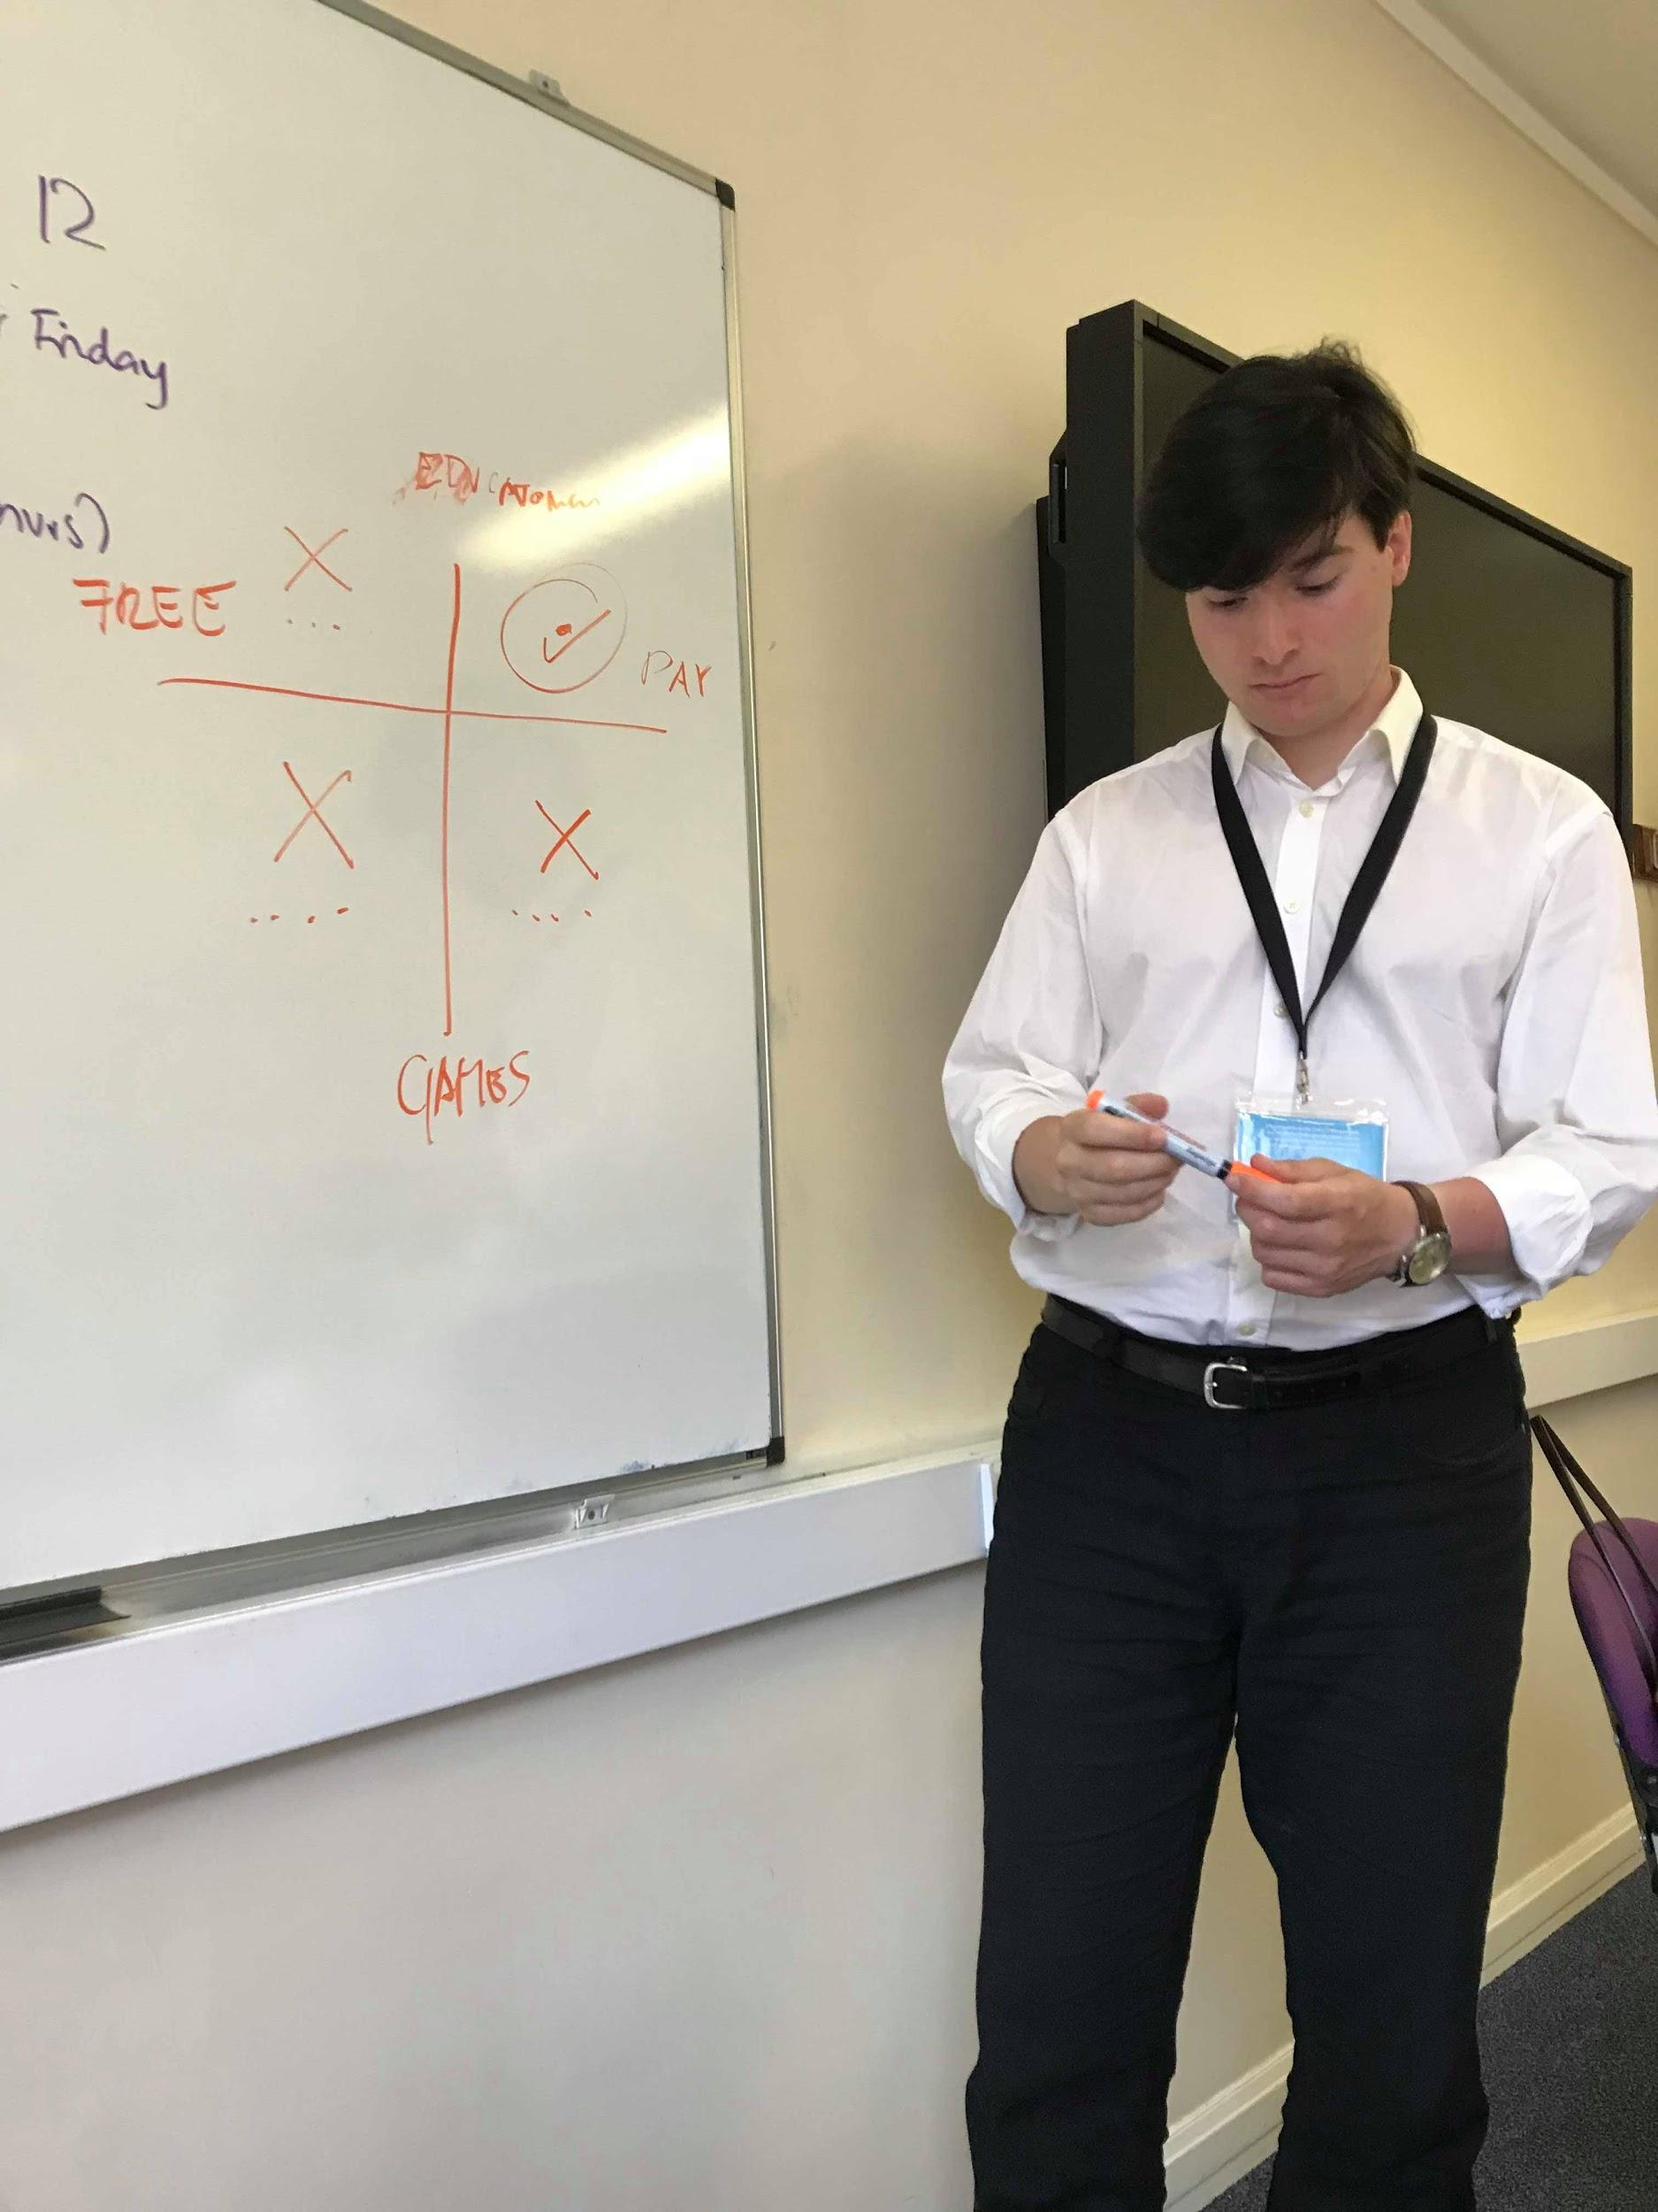
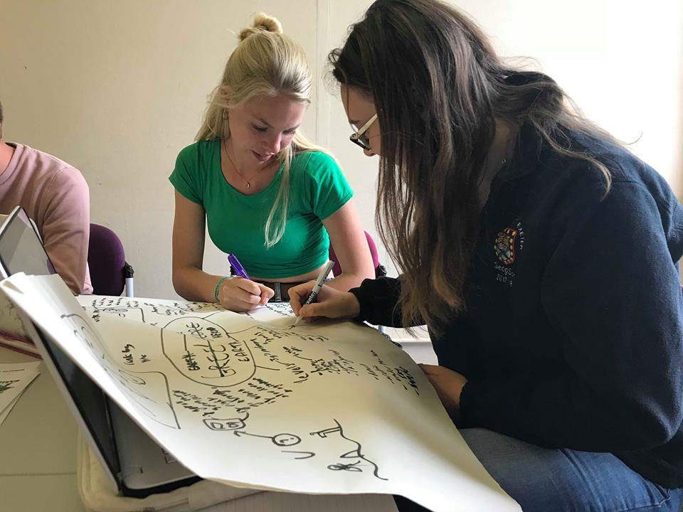
Week Progress

Slide 14
Financial Budget
Design & Maintenance | £2000
Advertisement | £3000

Slide 15
An app designed to educate and engage children about climate change

